Slide 1
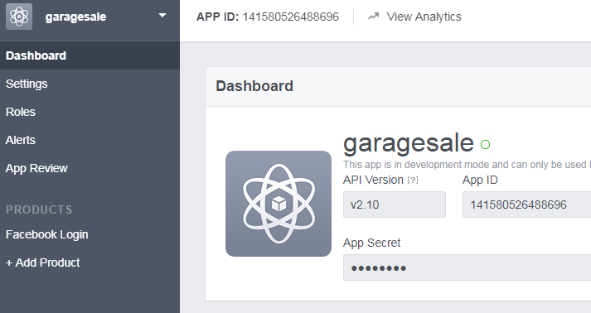
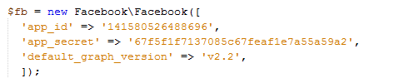

Log in with FB
Add library “ Facebook SDK for PHP”.
2. Create an app in developers.facebook.com
3. Create Application instance by ID and secret code
4. In callback URL ,analyze the response and retrieve user data

